Slide 1

Nerve Action Potential :2
Dr.Viral I. Champaneri, MD
Assistant Professor
Department of Physiology

Slide 2
Learning Objectives
Stages of Action Potential
  Repolarization
  Positive afterpotential
  After hyperpolarization
Resting membrane potential of neuron
Effect of Increase / Decrease level of Na⁺
Effect of Increase / Decrease level of K+
Role of other Ions

Slide 3
2. Depolarization ➔ Overshoot
In Large nerve fibers,
Membrane potential ➔ “Overshoot”
Beyond zero level ➔
Becomes ➔ Somewhat positive

Slide 4
2. Depolarization ➔ Overshoot
Smaller fibers and
Many Central nervous system (CNS) neurons
The potential merely approaches the zero level
Does not overshoot to the positive level

Slide 5
2. Depolarization ➔ Overshoot
During overshoot
Direction of electrical gradient
For Na⁺ is reversed

Slide 6
2. Depolarization ➔ Overshoot
Because
Membrane potential is reversed
Limits Na⁺ influx
Voltage gated K⁺ channels ➔ Open

Slide 7
Rising membrane potential
Within
Fraction of a millisecond
Causes

Slide 8
Rising membrane potential
Beginning of Closure of
  Sodium channels
Opening of
  Potassium channel
Action potential terminates

Slide 9
3. Repolarization stage of action potential
Within few 10,000ths of a second
Na⁺ channels begin to close
After membrane becomes
Highly permeable to K⁺ ions

Slide 10
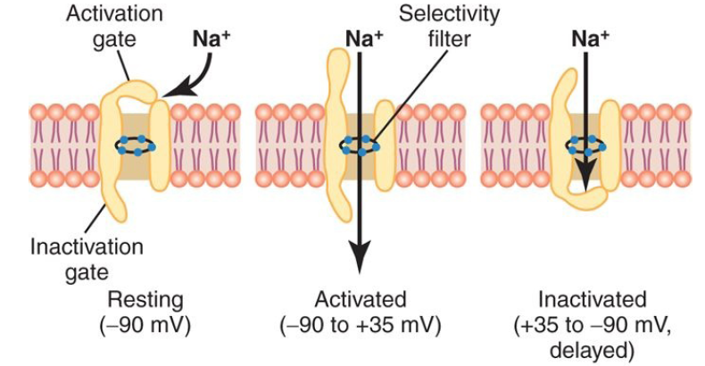
3. Repolarization stage of action potential

Slide 11
3. Repolarization stage of action potential
The K⁺ channels open
More than normally
Rapid diffusion of K⁺ ions to the exterior
(Higher Concentration to Lower Concentration)

Slide 12
3. Repolarization stage of action potential
Re-established
The normal negative resting membrane potential (RMP: -90 mV ) called
Repolarization

Slide 13
3. Repolarization stage of action potential
Opening of the voltage-gated K⁺ channels
Slower & more prolonged
Than ➔ Opening of the Na⁺ channels

Slide 14
3. Repolarization stage of action potential
Increase in K⁺ conductance
Comes after
The increase in Na⁺ conductance

Slide 15
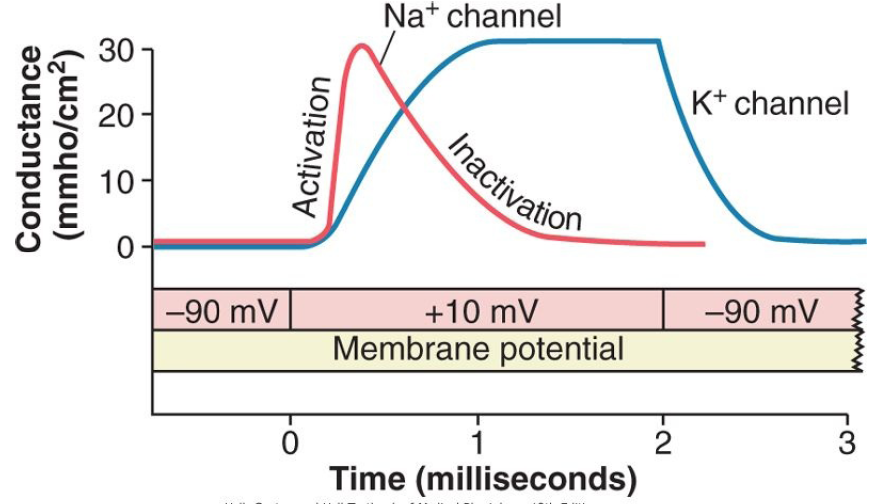
Conductance of Na⁺ ion channels

Slide 16
Conductance of the K⁺ channels
Where as the potassium channels ➔
Only open (Activate)
And the rate of opening is much Slower than for sodium channel (Prolonged)

Slide 17
Voltage-Gated Potassium Channel
During the Resting stage:
The Gate of the potassium channel is
Closed

Slide 18
Voltage-Gated Potassium Channel
Potassium ions are
Prevented from passing through this channel
To the exterior

Slide 19
Voltage-Gated Potassium Channel
When membrane potential rises
From -90mV ➔ Towards Zero
Voltage change
Cause slow conformational opening of the gate
Allows increased potassium diffusion outward

Slide 20
Slowness of the K⁺ Channels ➔
K⁺ channels open ➔ Just at the same time
Na⁺ channels ➔ Beginning to close
Due to ➔ Inactivation

Slide 21
3. Repolarization stage of action potential
The net movement of positively charge
Out of the cell
Due to K⁺ efflux ➔ Completes
The process of repolarization

Slide 22
Stages of Nerve Action Potential
Resting stage
Depolarization stage and Overshoot
Repolarization stage
After-hyperpolarization

Slide 23
4. “Positive” After potential
Membrane potential becomes more negative
Than ➔ Original RMP (- 90 mV)
For few milliseconds
After action potential ➔ Over

Slide 24
4. “Positive” After potential
“Positive” after potential is ➔ Misnomer
Because positive afterpotential
Is even more negative
Than resting membrane potential (RMP =-90mV)

Slide 25
4. “Positive” After potential
Reason for calling it “Positive” ➔ Historically
The first potential measurement
Were made on
The outside of the nerve fiber membrane
Was ➔Positive

Slide 26
4. “Positive” After potential
Than ➔ The inside
When measured on the outside
This potential causes a positive record
Rather than a negative one

Slide 27
4. “Positive” After potential
Cause of the positive afterpotential ➔Mainly
Many potassium channels
Remain open for several milliseconds
After complete repolarization of the membrane

Slide 28
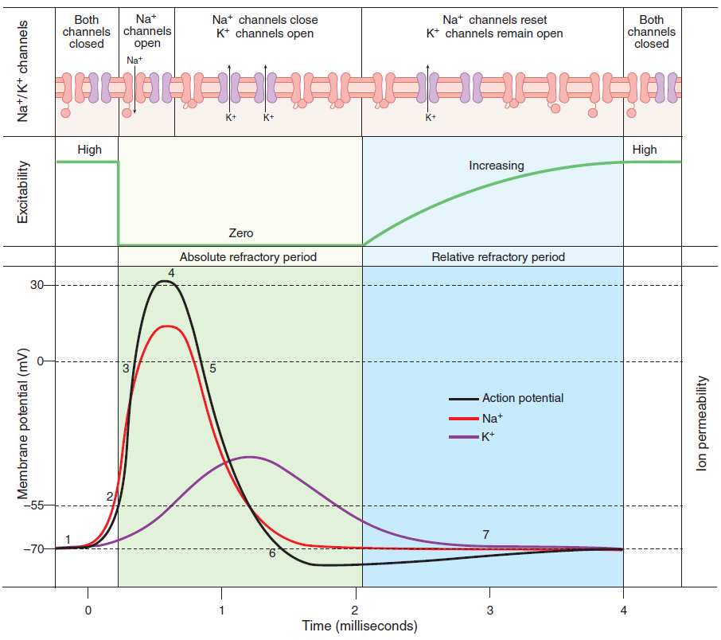
-65
-90

Slide 29
4. After-hyperpolarization
The slow return of the K⁺ channels
To the closed state explain
After-hyperpolarization
F/b return
To the resting membrane potential

Slide 30
5. End of action potential
Voltage-gated K⁺ channels
Bring the action potential ➔ To the end
Cause closer of their gates through
Negative feedback process

Slide 31
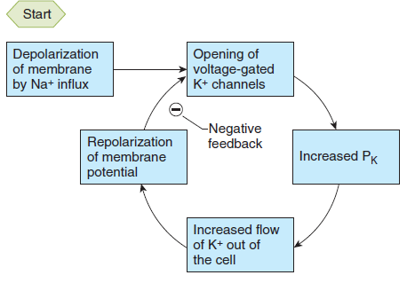
Negative feedback loop during Repolarization

Slide 32
Resting Membrane Potential in Neurons
About -70mV ➔
Close to the equilibrium potential for K⁺
Because there are more open K⁺ channels
Than Na⁺ channels at rest
Membrane permeability to K⁺ is greater at rest

Slide 33
Resting Membrane Potential in neurons
Intracellular and extracellular
Concentration of K⁺
Prime determinant of the RMP (Nernst potential)
Therefore
RMP is close to equilibrium potential of K⁺

Slide 34
Decrease ECF level of Na⁺➔AP
Decrease ECF [Na+] ➔ Hyponatraemia
The external level of Na⁺ concentration
Reduce the size of action potential

Slide 35
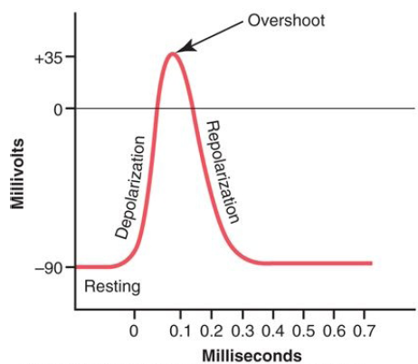
Depolarization stage of action potential

Slide 36
Decrease ECF level of Na⁺➔ RMP
Hyponatraemia ➔ Little effect on the RMP
Because
Permeability of the membrane to
Na⁺ at rest is relatively low

Slide 37
Decrease / Increase ECF level K⁺
Resting membrane potential
Is close to equilibrium potential for K⁺
Change in external concentration of K⁺ ions
Major effects on the RMP

Slide 38
Increase ECF level K⁺ ➔ Hyperkalemia
ECF level of K⁺ is increased ➔ Hyperkalemia
The RMP ( of Neuron : -70 mV) moves closer
To the threshold for eliciting an action potential
Neuron becomes ➔ More excitable

Slide 39
Decrease ECF level K⁺ ➔ Hypokalemia
ECF level of K⁺ is Decreased ➔ Hypokalemia
RMP (-70mV) ➔ Reduced
Neuron ➔ Hyperpolarized

Slide 40
Role of other Ions During the Action Potential
Impermeant Negatively Charged Ions (Anions) inside the Axon
Calcium Ions

Slide 41
Impermeant Anions inside the axon
Inside the axon
Many negatively charged ions (Anions)
That can not go through the membrane channels

Slide 42
Impermeant Anions inside the axon
Includes ➔
Anions of the Protein molecules
Anions of many Organic phosphate compounds
Anions of Sulfate compounds

Slide 43
Impermeant Anions inside the axon
Because these ions
Cannot leave the interior of the axon

Slide 44
Impermeant Anions inside the axon
Excess of these impermeant anions
Deficit of positive ions inside the membrane

Slide 45
Impermeant Anions inside the axon
Responsible
For the negative charge inside the fiber
When there is deficit of positive charged K⁺
And other positive ions

Slide 46
Calcium Ions
Membranes of almost all cells of the body
Have Ca²⁺ pump
Similar to Na⁺ pump

Slide 47
Calcium ions serves ➔
Along with or Instead of Na⁺
In some cells
To cause most of action potential

Slide 48
Calcium pump ➔
Like
Sodium (Na⁺) pump
Pumps Ca²⁺ ions

Slide 49
Calcium pump ➔ Ca²⁺
From the interior
To the exterior of the cell membrane
Or
To endoplasmic reticulum (ER)

Slide 50
Calcium ions gradient ➔
Of 10,000 folds due to it
Internal cell concentration of calcium ions of
10⁻⁷ molar
External concentration of 10⁻³ molar

Slide 51
Voltage gated Ca²⁺ Channels
Slightly permeable to Na⁺ ions also
When channels open ➔ Both Ca²⁺ and Na⁺ ions
Flow exterior of the fiber

Slide 52
Ca²⁺-Na⁺ Channels ➔ Slow channels
Slow to activation
Require ➔10-20 times a long for activation
As the ➔ Sodium channels ➔ Fast channels

Slide 53
Ca²⁺ channels ➔Numerous
Cardiac muscle
Smooth muscle

Slide 54
Some types of Smooth Muscle
Fast sodium channels
Hardly present

Slide 55
Some types of Smooth Muscle
Action potential caused ➔ Entirely by
Activation of the slow calcium channels

Slide 56
Mechanism : Ca²⁺ affect the Na⁺ channel
Ca²⁺ ions bind ➔
To the exterior surfaces of
The Na⁺ channel protein molecules

Slide 57
Mechanism : Ca²⁺ affect the Na⁺ channel
Positive charges of Ca²⁺ ions
In turn
Alter the electrical state of the channel protein itself

Slide 58
Mechanism : Ca²⁺ affect the Na⁺ channel
Altering the voltage level required
To open ➔ The sodium gate

Slide 59
Voltage-Gated Sodium Channel
Outside
Inside

Slide 60
Deficit of Calcium Ions (Hypocalcaemia)
Na⁺ channels become activated (Opened)
By very little increase
Of the membrane potential
From normal very negative level

Slide 61
Calcium Ions falls 50% below normal
Spontaneous discharge in peripheral nerves

Slide 62
Calcium Ions falls 50% below normal
Often causing muscle “Tetany”
Lethal ➔ Death
Tetanic contraction of the respiratory muscles

Slide 63
Attend Your Roll Call

